Slide 1
District 6920 Membership Steve Williams, Chairman Diversity, Equity, & Inclusion Charles E Richardson, Chairman Innovative Club Advocates Steve Barnes, Chairman Gordon Matthews, Co-Chairman Alfie Cofield, Rotary Club Prospects Coordinator Area Membership Advocates

Slide 2
Membership
Vision/Goal, Mission, Focus, Purpose
Recruitment
Engagement
Diversity, Equity, and Inclusion
Innovative Club Association
Best Practices

Slide 4
Prospective Members
When your club is vibrant, innovative and making a difference in your community, it will attract prospective members.
Bringing in new, qualified members diversifies your club and increases its impact.
This may be the first contact a prospective member has with a club, be sure to make it a positive one.

Slide 5
YOUR PROSPECTIVE MEMBERS
• A qualified person proposed by one of your club’s members
• Someone who approached your club
• Someone identified by your club
• A candidate who expressed interest through Rotary.org’s Join page
• A former Rotarian who is interested in rejoining*
• A current Rotarian who wants to change clubs*
• A qualified person referred by a Rotarian from another club*

Slide 6
CORPORATE MEMBERSHIP
Do you know a local professional who wants to be part of Rotary, but is worried about having enough time?
Do you want to establish a connection or partnership with an area business or corporation?
If the answer is yes, corporate memberships might be an option for your club.

Slide 8
Depends on How You Look at it

Slide 9
From RI President Jennifer Jones
During 2022-23, I encourage all of us — as individuals, in our clubs, and in our districts — to exemplify our commitment to diversity, equity, and inclusion. We can each do our part to advance DEI by:
1. Learning more about DEI in Rotary
2. Determining why DEI matters in our own club and our own area, and how using these principles can help our club grow and make it stronger
3. Raising awareness and increasing understanding about DEI
4. Taking action on DEI in our clubs and in our communities

Slide 10
DIVERSITY
• Demographic diversity (our gender, race, sexual orientation, age and so on)
• Experiential diversity (our affinities, hobbies, and abilities)
• Cognitive diversity (how we approach problems and think about things)

Slide 11
EQUITY

Slide 12
INCLUSION
The act of intentionally creating a space of belonging, engagement, and empowerment for a diverse group of people.

Slide 13
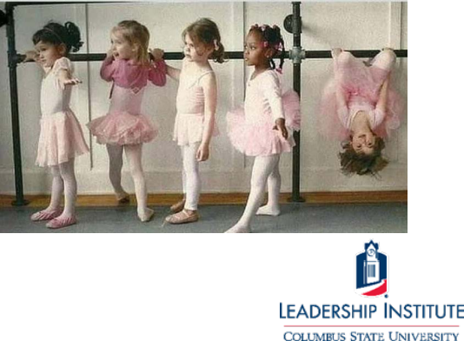
Equity is being on the party planning committee
Diversity is being invited to the party
Inclusion is being asked to dance
Belonging is feeling free to dance whenever you want.
Belonging is about mattering, identification, social connection, a sense of being accepted and included by those around you

Slide 14
Diversity Equity & Inclusion Chairman Charles Richardson

Slide 15
CLUB INNOVATION
Starting a Rotary Club — Learn what you need to do to form a club.
Starting a club – This Learning Center course walks you through the process of starting a new club, whether it's a Rotary, Rotaract, innovative, or satellite club.
Rotary Club Models — All clubs share similar values and a passion for service, but no two clubs are the same because each community has its own unique needs. Learn about different club models that will attract new audiences in your region.
Guide to Satellite Clubs — Understand the benefits a satellite club can have and the steps for starting one.
Guide to Passport Clubs — Learn how clubs can operate in a way the gives their members freedom to attend other club meetings and events and fulfill their own club obligations through service efforts.

Slide 16
Innovative Club Advocates
Chairman
PDG Steve Barnes
Co-Chairman
PDG Gordon Matthews

Slide 17
Audley Knight
Regional Membership Officer
Membership Development
Tel 1.847.866.3095
Mobile 1.678.800.2176
Audley.Knight@rotary.org

Slide 18
We are prepared for an exciting year of growth!
“Thank you”
District Governor Heather Kellen

